Slide 1


IOT Project
By,
Akshita Gulati

Slide 2
Purpose
The purpose of this presentation is to put forward an idea that can solve a common problem related to mails which most of us face daily
The solution is developed by keeping “Internet of Things” in mind
Note: This project is basically still in its “First phase” and more changes will be implemented in the future.

Slide 3

Contents
Objectives
The Common Problem
Solution
Fritzing - prototype
Setup and Method
Analysis
Resources
Future implementations
Summary

Slide 4
Objectives
To develop a system that would easily manage mails
To automate the mailing process by sending real time notifications when the mailbox has opened/closed
To contribute to society's move to sustainable development

Slide 5
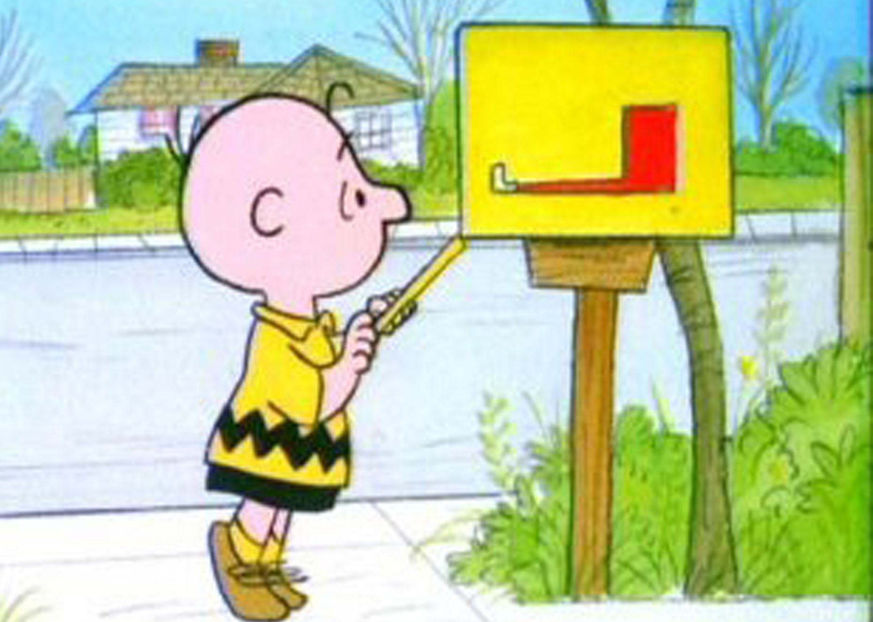
The Common Problem
Sick of walking all the way down your long driveway just to check your mail?
Waiting on a special package and want to know as soon as it arrives?
Never let anyone you care about walk out to an empty mailbox

Slide 6
Solution
My solution to this problem is the “Mailing system”
With the help of this Mailing system an individual would know when his mailbox is opened (or) closed etc with the help of a notification on his phone

Slide 7
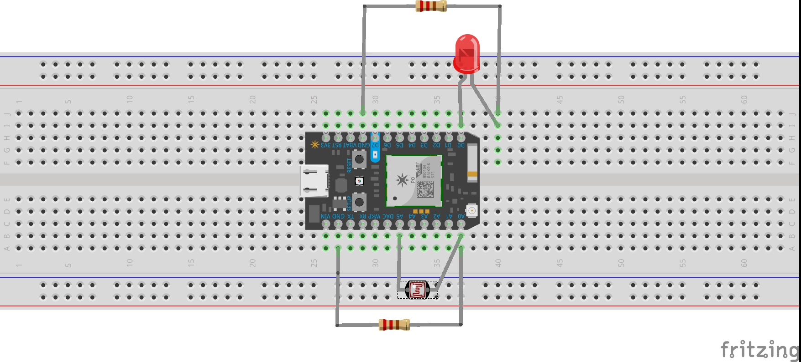
Fritzing - Prototype

Slide 8
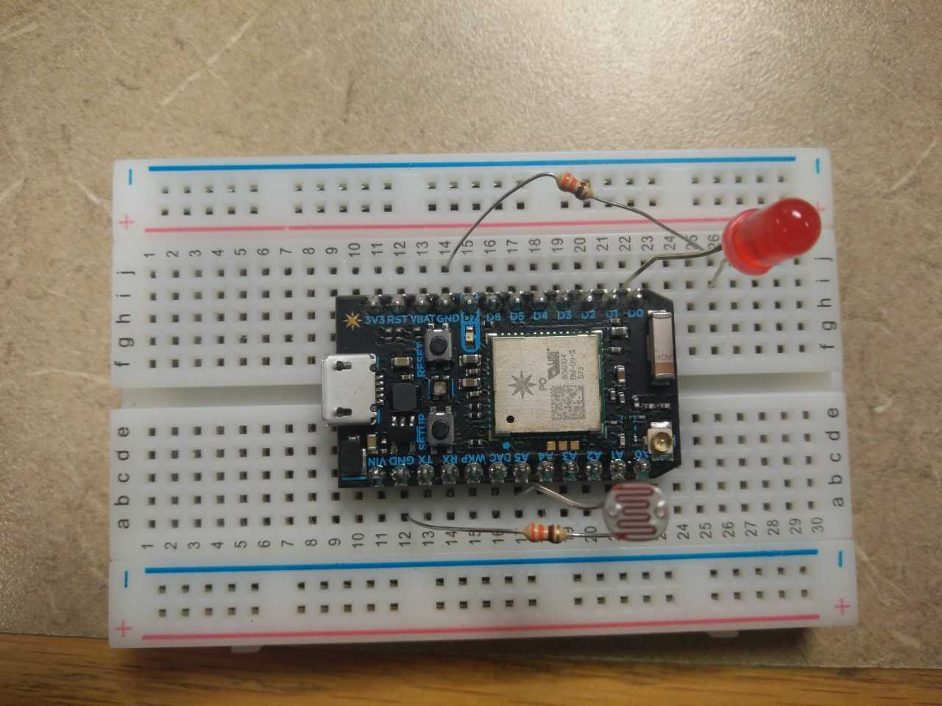
Setup

Slide 9
Method
This project uses a photon, photoresistor combined with a 220ohm resistor to determine if the mailbox is opened or closed
This setup will publish an event when the beam of light between the LED and the photoresistor is broken(mailbox opened). It will also publish a event when the light is intact again(mailbox closed) via Particle.Publish()
IFTTT is utilized to deliver notifications to a mobile phone. The recipe was set up to look for events published from the photon from the Particle.Publish line in the code

Slide 10
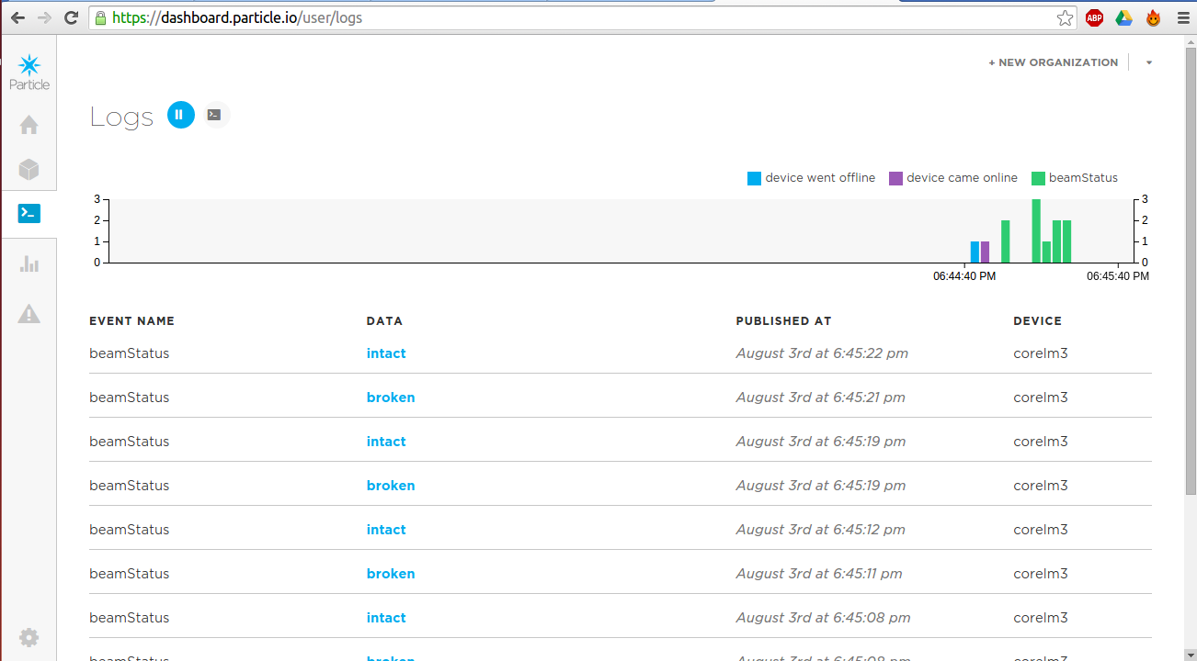
Analysis on Particle Console

Slide 11
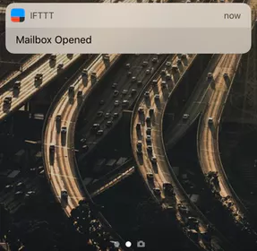

Analysis using
On the basis of the trigger generated, the IFTTT sends notifications on the mobile phone

Slide 12
Resources
Internal Resources(In the kit)
Particle Photon
Photo resistor
Resistors
External Resources(Not in the kit)
IFTTT

Slide 13
Future Implementations
Phase-II
Sending a notification accurately to determine if the mailbox is just opened or a mail has actually been placed in it i.e. using the sensitive resistor
Instead of only a notification on the individual's mobile also setup a alarm on its own that buzzes one’s the mail has arrived
Phase-III
Any suggestions from professors and fellow students

Slide 14
Summary
Therefore in this way by using this Mailing system an individual can easily know when a mail arrives and they don’t have to always stand by the mail box waiting for an important mail.

Slide 15
Questions

Slide 16
Thank you

